Slide 1



Analyzing Agricultural Productivity Across Indian States using Power BI

Slide 2

Learning Objectives
GOAL
Understand state-wise agricultural trends using real-world datasets
Explore how rainfall, fertilizer, and pesticide use affect crop productivity
Develop Power BI dashboards for interactive data storytelling
Analyze year-wise and crop-wise agricultural performance
Source :
www.freepik.com/

Slide 3
Tools and Technology used
Slicers, Filters, Visual-level Interactions in Power BI
Power BI Desktop
Microsoft Excel (for initial data review)
GitHub (for version control and submission)

Slide 4
Methodology
Imported and cleaned agricultural data (area, production, yield, etc.)
Created interactive dashboards in Power BI
Visualized trends using line charts, bar graphs, maps, and KPIs
Added slicers for year, state, and crop filtering
Analyzed correlations between fertilizer/pesticide use and yield

Slide 5
Problem Statement:
India’s agricultural sector contributes significantly to GDP and employment, yet productivity varies widely across states and crops. There’s a need for data-driven insights to understand these variations and improve decision-making.

Slide 6
Solution:
Built an interactive Power BI dashboard to visualize and analyze crop productivity, rainfall, fertilizer and pesticide use across Indian states and years. The dashboard highlights top-performing crops and states, trends over time, and input-output relationships.

Slide 7
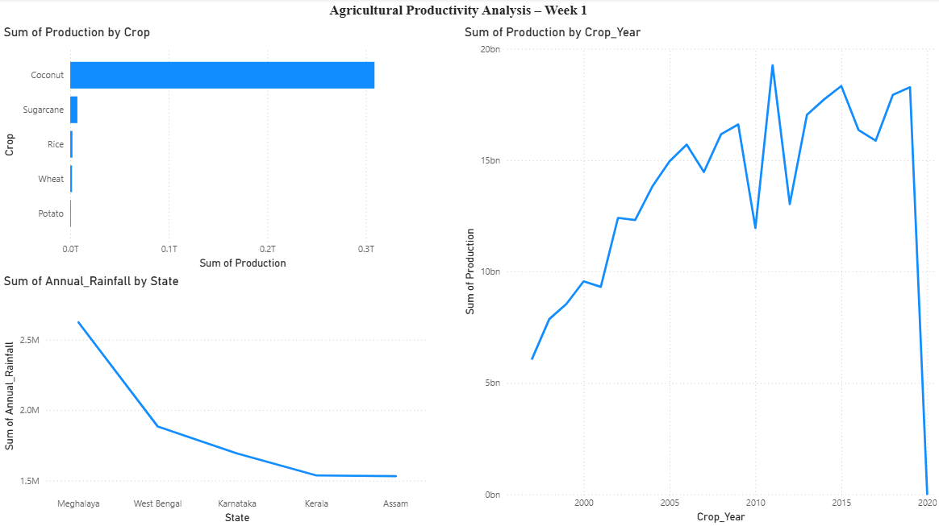
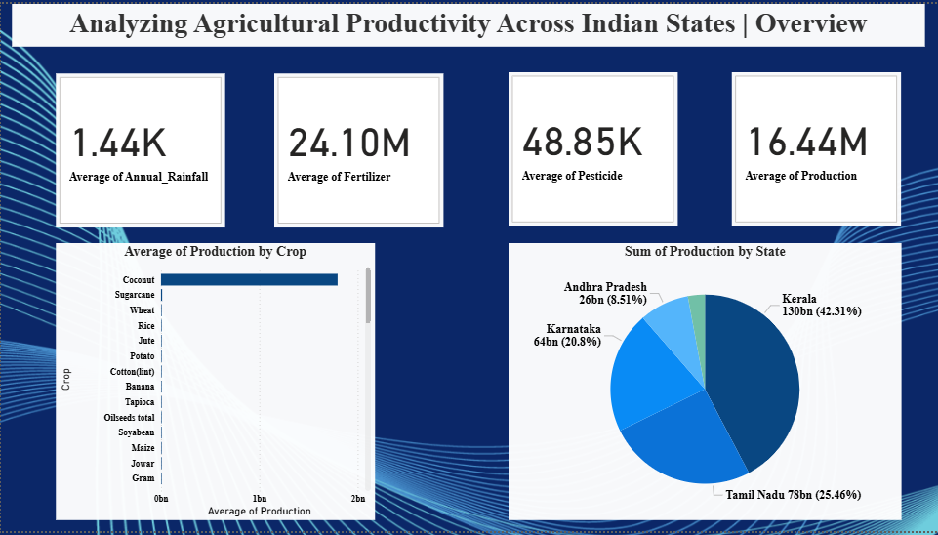
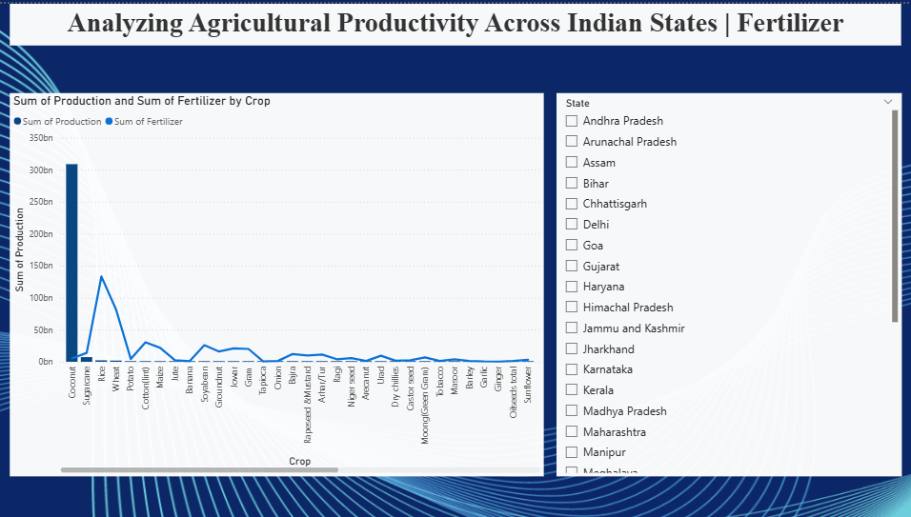
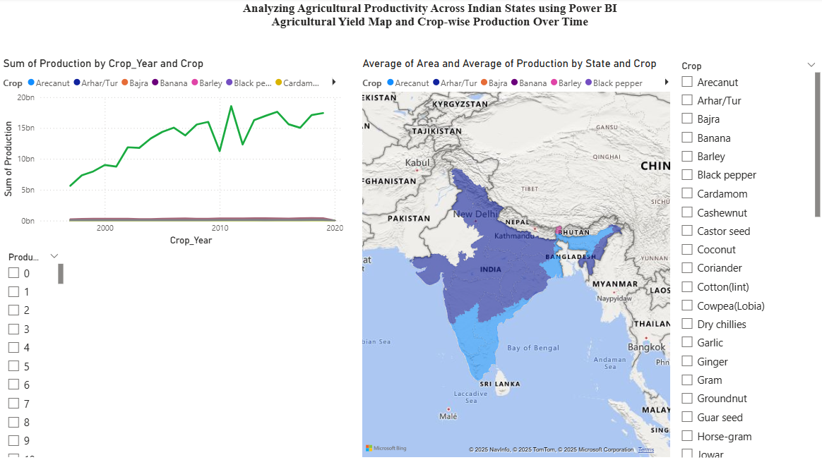
Screenshot of Output:

Slide 8
Conclusion:
Gained insights into how different factors impact crop productivity
Identified top-performing crops and states based on yield and production
Interactive dashboards provide quick, state-wise agricultural insights
Built strong foundational skills in Power BI, data visualization, and analysis

